Slide 1
Dimensionality Modelling
Advanced databases 16/10/23

Slide 2
Content
Dimensionality Modelling
Definitions
Schemas
Dimensional Model vs Entity Relationship
Dimensional Modeling Stage of Kimball’s Business Dimensional Lifecycle

Slide 3
Definitions – Dimensional Models
Dimensionality Modelling (DM): a logical design technique to present data in a standard, intuitive form to allow high-performance access.
A DM forms a ‘star-like’ structure, called a star schema or star join.

Slide 4
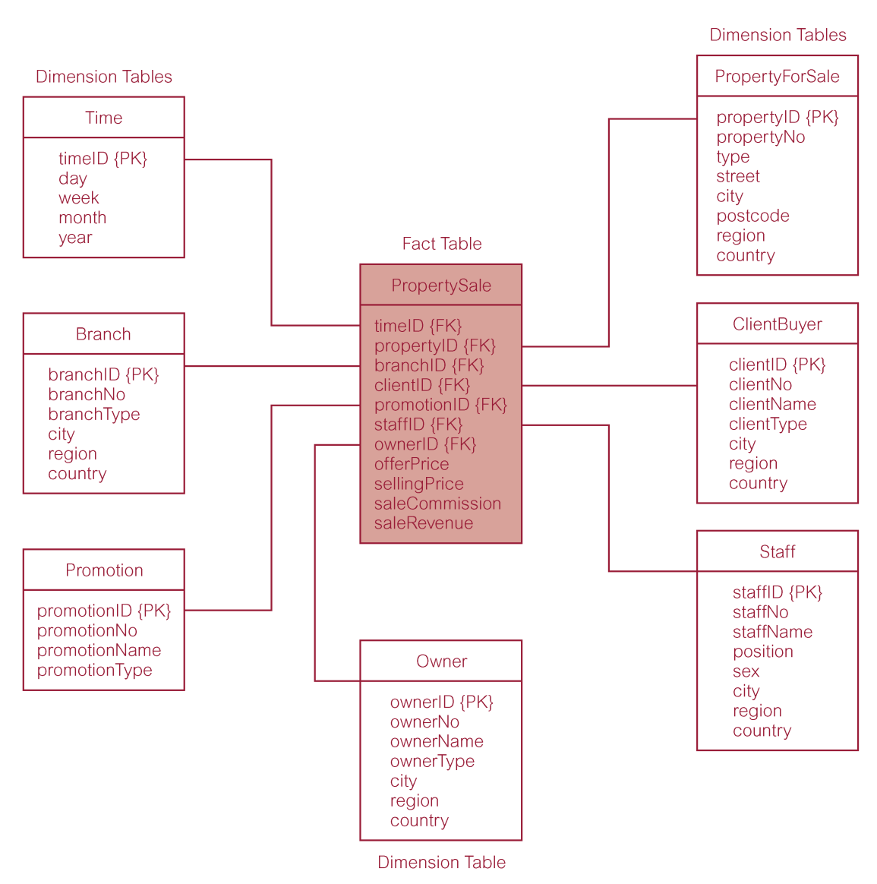
Definitions - Keys
A DM is composed of one table with composite primary keys, called a fact table, and a set of smaller tables called dimension tables.
Simple (non-composite) primary key: Each dimension table has one of these that corresponds to one component from the composite key in the fact table.
Notes:
Composite key for fact table is made up of the combination of simple primary keys from the other tables.

Slide 5
Definitions - Keys
Natural keys are replaced with surrogate keys. Meaning that all dimension and fact table joins are done using the surrogate keys instead.
This is so the warehouse can independently decide how to store data instead of using the OLTP indexes.

Slide 6
Definitions - Facts
Star schema’s are logical structures containing fact tables in the center, surrounded by denormalized dimension tables.
Facts are generated by events occurring in the past.
Most data is contained in the fact table.
Once inserted the facts should be read-only.
Useful fact tables are usually numerical, or additive.

Slide 7
Definitions – Dimension tables
Dimension tables usually contain descriptive textual information.
Dimension attributes are used as constraints in data warehouse queries.
Star schemas can be used to speed up query performance by denormalizing reference information into a single dimension table.

Slide 8
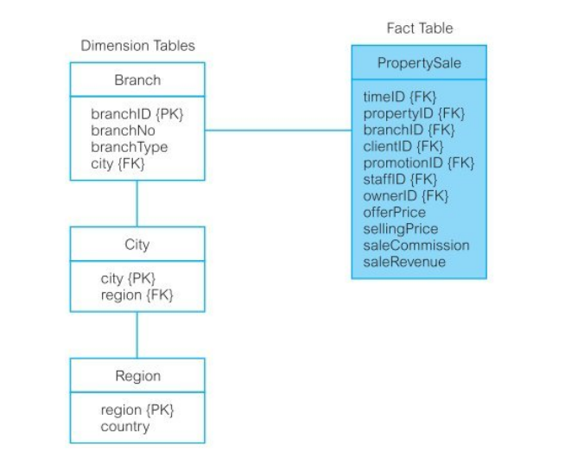
Snowflake schema
Snowflake schema: a variant of star schema that has a fact table at the center, surrounded by normalized dimension tables.
Starflake schema: a hybrid structure that contains a mixture of star and snowflake dimension tables.

Slide 9
Dimensional Modelling Advantages
Star, Snowflake, and starflake representations have the following advantages:
Efficiency
Handling of changing requirements
All dimensions are equivalent to access to the fact table
Extensibility
Adding new facts
Adding dimensions
Added dimensional attributes
Breaking down to lower levels of granularity
Ability to model business situations
Predictable query processing

Slide 10
Comparing DM and ER models
Entity Relationship
A single ER model normally decomposes to multiple DMs.
Used for identifying relations among entities to remove redundancy.
Dimensional Model
Multiple DMs are associated through ‘shared’ dimension tables.
Attraction is the high performance of ad-hoc user queries.
Notes:
ER normally used for OLTP
DM normally used for Data Warehouse/Mart

Slide 11

Dimensional Modeling Stage of Kimball’s Business Dimensional Lifecycle
This stage can result in the creation of a DM for a data mart or to dimensionalise a schema for an OLTP.
Starts by defining high-level dimensional model, which progressively gains detail and is achieved in a two-phased approach:
Creation of a high-level DM – this has 4 steps
Adding details to the model through identification of dimensional attributes for the model.

Slide 12
Phase 1 – Step 1: Select Business Process
The process refers to the subject matter of a particular data mart.
The first data mart built should be:
one most likely to be delivered on time
within budget
Answer the most commercially important questions.

Slide 13
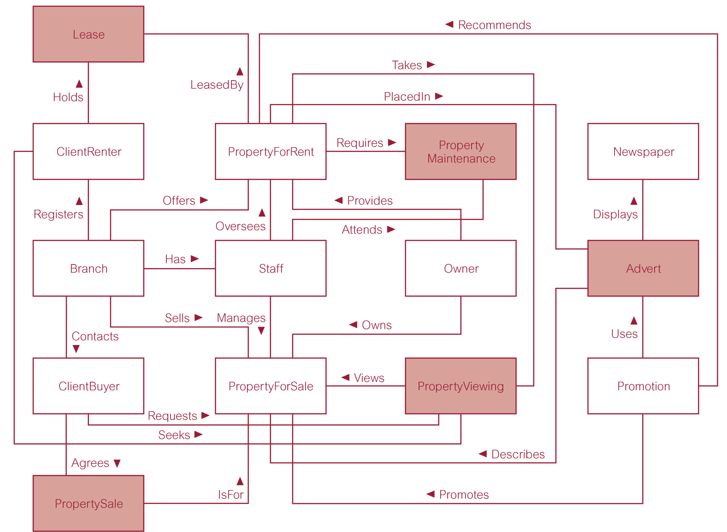
ER model of extended version of DreamHome example
Notes:
The green highlight shows the entities related to sales and will allow us to build our own datamart based on the data requirements of the property sales business process.

Slide 14
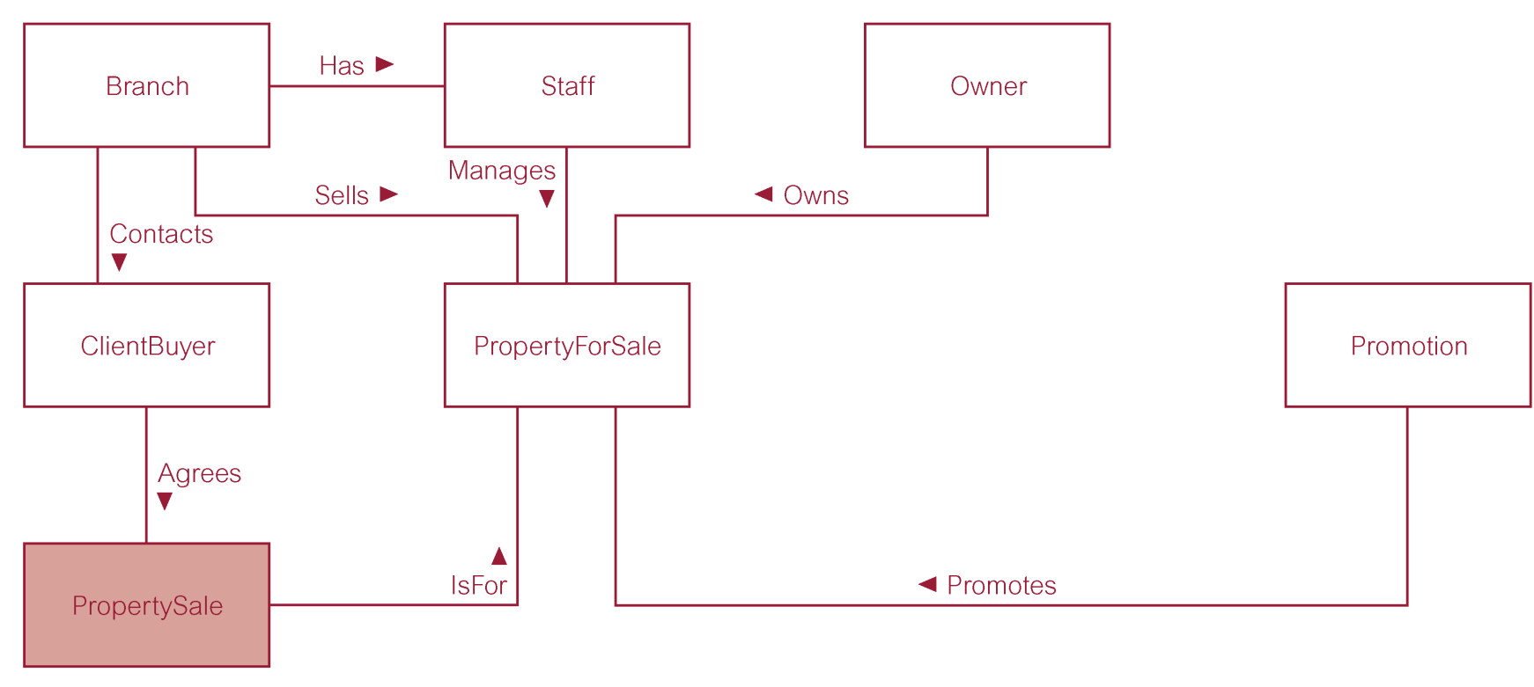
ER model of property Sales Business process of DreamHome example
Notes:
The green highlight shows the entities related to sales and will allow us to build our own datamart based on the data requirements of the property sales business process.

Slide 15
Phase 1 – Step 2: Declare Grain
Decide what each record of the fact table will represent.
Identity dimensions of the fact table.
The grain decision for the fact table determines the grain of each dimension table.
Include time as a core dimension, which is always present in star schemas.
Notes:
Grain: if the property sales record individual sales, then the client dimension records each individual client that bought that property.

Slide 16
Phase 1 – Step 3: Choose Dimensions
Dimensions set the context for asking questions about the facts in the fact table.
If a dimension occurs in two data marts, the must be exactly the same dimension, or one is a subset of the other.
A dimension used in more than one data mart is referred to as being a conformed dimension.
Notes:
Conformed dimensions allow for drill across queries: different fact tables can be used to analyze their joined data in the same query.

Slide 17
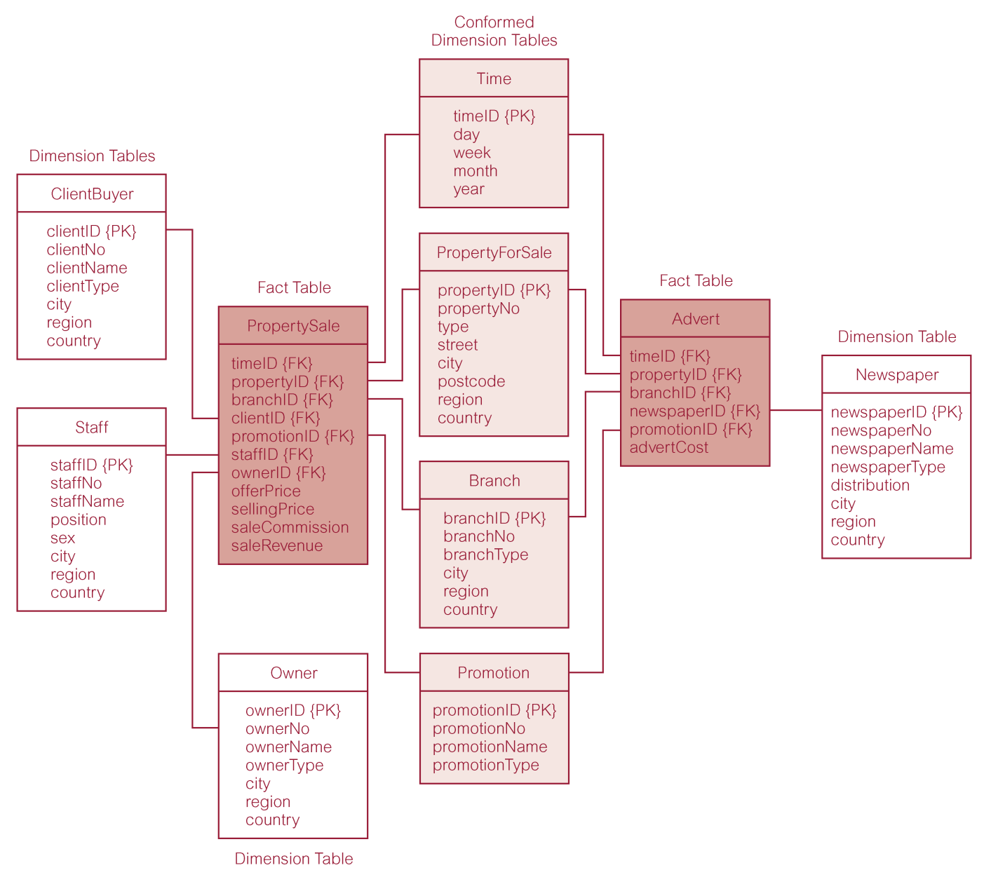
Star schemas for property sales and property advertising

Slide 18
Phase 1 – Step 4: Identify Facts
The grain of the fact table determines which facts can be used in the data mart
Facts should be numeric and additive.
Non-Usable facts include:
Non-numeric facts
Non-additive facts
Facts at different granularity from other facts in the table
Once facts are selected each should be re-examined to determine if there are opportunities to use pre-calculations

Slide 19
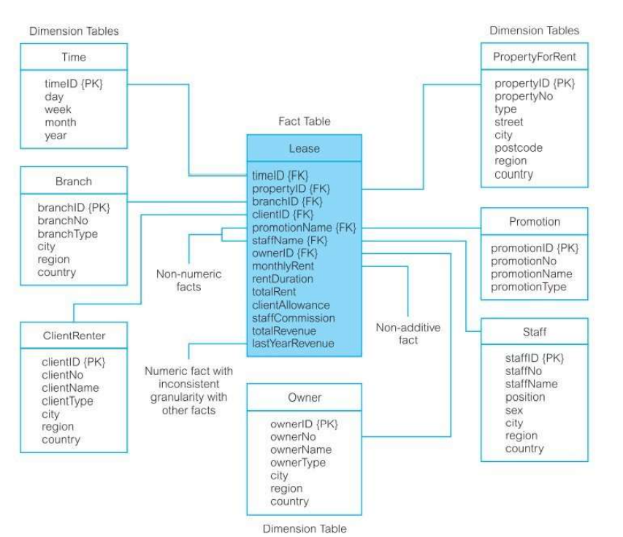
Phase 1 – Step 4: Identify Facts –bad facts table

Slide 20
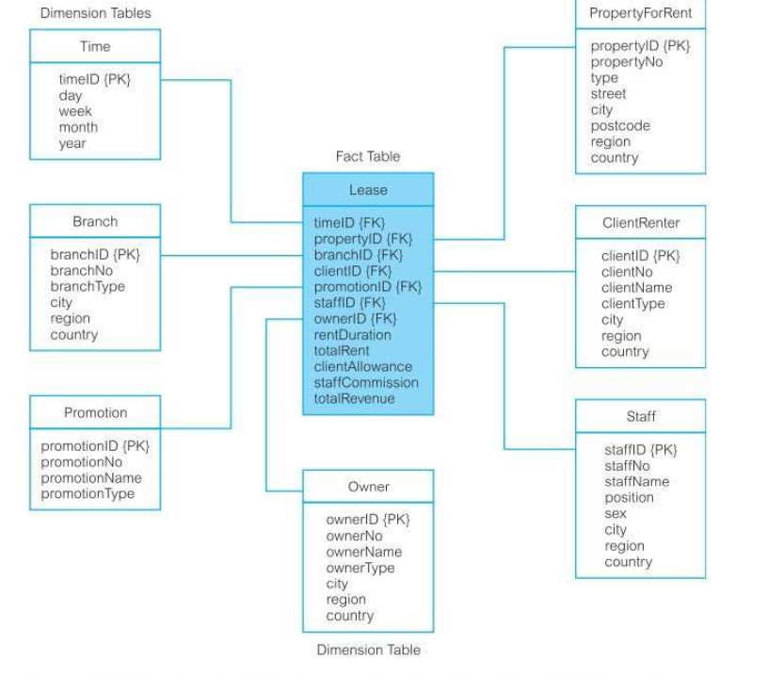
Phase 1 – Step 4: Identify Facts – corrected facts table

Slide 21
Phase 2: Identify all dimension attributes for DM
This involves adding attributes to dimension tables.
They are identified by the business requirements analysis to analyse the given business process.
Text descriptions are added to the tables and should be intuitive and understandable to users.
Usefulness of data mart will be determined by the scope and nature of these attributes.

Slide 22
Issues while developing dimensional models
Choosing a duration of a database:
How far back the database goes.
Some enterprises want information a year or two earlier for comparison (sales).
Others legally require documents extending back 5 or more years (insurance).
Older data typically has problems with reading and interpretation.
Slowly changing dimension problem: important for old versions important dimensions be used and not the current ones.

Slide 23
Slowly Changing dimension Problem
Example: the proper description of the old client and old branch must be used with old transaction history.
Data warehouse must assign a key to these dimensions to distinguish multiple snapshots of clients and branches over time.
3 Types of slowly changing dimension:
Changed dimension attribute overwritten.
Changed dimension causes new dimension record to be created.
Old attribute changed to an alternate attribute so both old and new values of attribute are simultaneously available.

Slide 24
Kimball’s Business Dimensional Lifecycle
Produces a data mart that supports the requirements of a particular business process.
Allows easy integration with other related data marts to form an enterprise-wide data warehouse.
A dimensional model containing more than one fact table sharing more than one conformed dimension tables is referred to as a fact constellation.

Slide 25
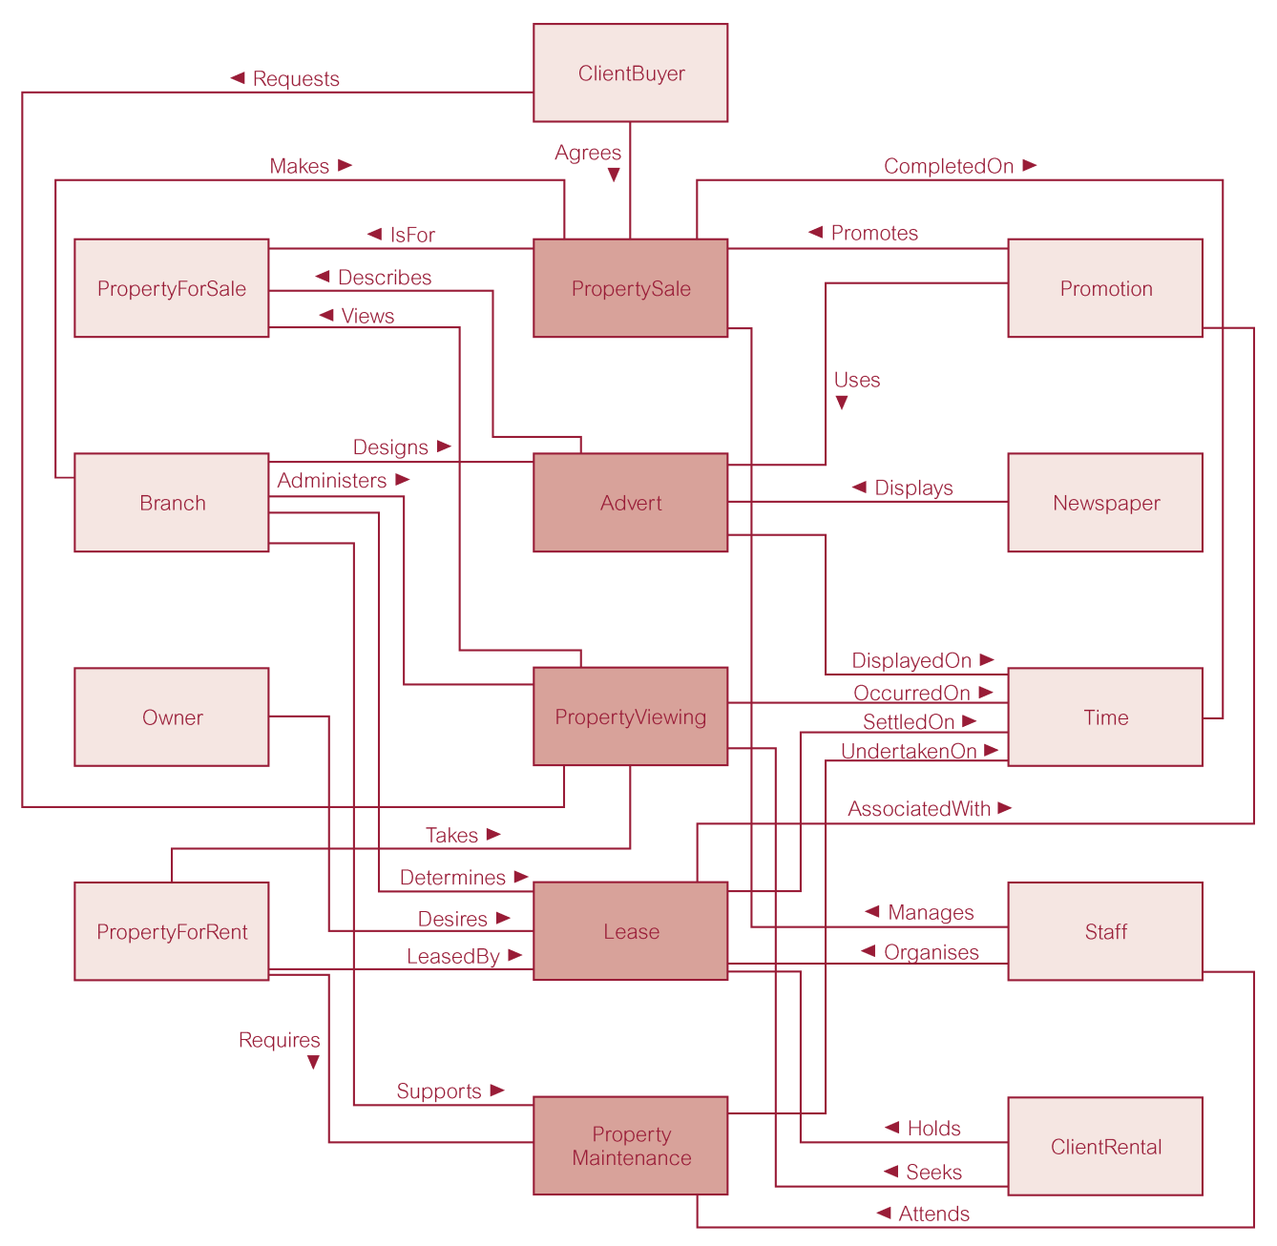
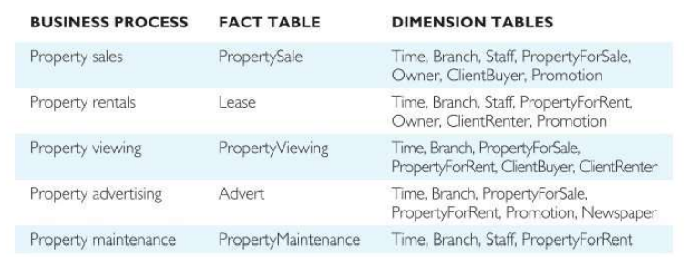
Dimensional model (fact constellation) for DreamHome data warehouse

Slide 26
Summary
Definitions
Schemas
Dimensional Model vs Entity Relationship
Dimensional Modeling Stage of Kimball’s Business Dimensional Lifecycle

